Slide 1


SMART INDIA HACKATHON 2024
TITLE PAGE
PS Title :- Assured Contract Farming System for Stable Market Access
Theme- Agriculture , Foodtech & Rural Development
PS Category- Software
Team ID-
Team Name – Team InnovateX

Slide 2



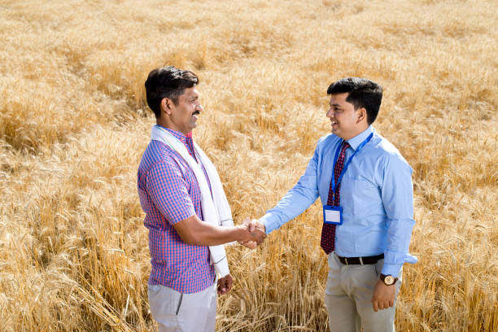
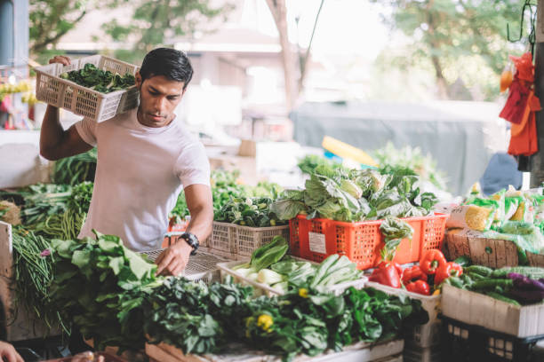
AGRICONNECT Empowering Farmers with Assured Market Access through Digital Contract Farming
Innovatex
Explanation :
Description:
Overview: Develop an online marketplace that connects farmers with buyers, ensuring stable market access and secure contracts.
Components:
Marketplace: A platform where farmers can list their produce and buyers can browse and place orders.
Contract Management: Tools for creating, negotiating, and finalizing contracts digitally.
Price Negotiation: Integrated features for real-time price negotiation based on market trends.
Payment Processing: Secure payment gateways for timely and reliable transactions.
Communication Tools: Messaging system for direct interaction between farmers and buyers.
Addressing the problem:
Details:
Guaranteed Market Access: Farmers can find and secure buyers more reliably, reducing market uncertainty.
Stable Income: By locking in buyers and prices, farmers can better plan and manage their finances.
Transparency and Security: Digital contracts and secure payments build trust and reduce risks of exploitation or disputes.
Innovation and Uniqueness :
Details:
Blockchain Integration: For transparent and tamper-proof contract management.
AI-Powered Price Predictions: To help farmers and buyers negotiate fair prices based on market trends.
User-Friendly Interface: Designed to be accessible even for tech-averse users, especially farmers with limited digital experience.
Comprehensive Support: Educational resources and support for users to make the most of the platform.

Slide 3







TECHNICAL APPROACH
Innovatex
Technologies to be Used
Frontend Technologies:
Programming Languages: JavaScript, HTML, CSS
Frameworks: React.js or Angular for building the user interface.
Backend Technologies:
Programming Languages: JavaScript (Node.js) or Python (Django/Flask)
Frameworks: Express.js for Node.js or Django/Flask for Python.
Database:
Types: SQL (MySQL, PostgreSQL) or NoSQL (MongoDB)
Payment Processing:
Gateways: Razorpay, Stripe, PayPal
Blockchain Integration:
Platforms: Ethereum or Hyperledger for secure contract management
AI Integration:
Tools: TensorFlow or PyTorch for price prediction models
Additional Tools:
APIs: For real-time price data and market trends
Hosting: AWS, Google Cloud, or Azure for scalable hosting
Methodology and Process for Implementation
Project Phases:
Phase 1: Planning and Research
Activities: Requirements gathering, market research, and technology selection.
Deliverables: Project plan, technical specifications.
Phase 2: Design
Activities: Designing UI/UX, creating wireframes, and developing system architecture.
Deliverables: UI/UX designs, wireframes, and architecture diagrams.
Phase 3: Development
Activities: Coding the frontend, backend, and integrating APIs and blockchain.
Deliverables: Working prototypes, codebase, and integration tests.
Phase 4: Testing
Activities: Unit testing, integration testing, and user acceptance testing.
Deliverables: Test reports, bug fixes.
Phase 5: Deployment
Activities: Deploying the platform to a production environment, configuring servers.
Deliverables: Live platform, deployment documentation.
Phase 6: Maintenance and Support
Activities: Ongoing maintenance, user support, and updates.
Deliverables: Maintenance logs, support tickets.

Slide 4
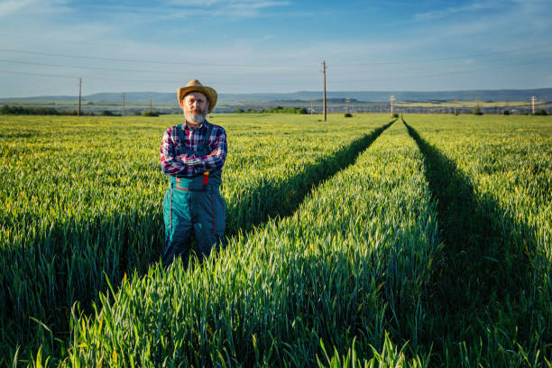



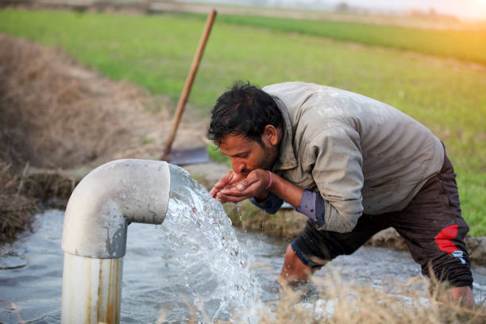
FEASIBILITY AND VIABILITY
Innovatex
Potential Challenges and Risks
Technical Challenges:
Integration Issues: Problems integrating various technologies (e.g., blockchain with payment systems).
Scalability: Ensuring the platform can handle increasing numbers of users and transactions.
Operational Risks:
User Adoption: Difficulty in convincing farmers and buyers to adopt the new platform.
Data Security: Protecting sensitive information and ensuring secure transactions.
Financial Risks:
Budget Overruns: Risk of exceeding the initial budget due to unforeseen expenses.
Funding Shortfalls: Potential challenges in securing additional funding if needed.
Analysis of the Feasibility of the Idea
Technical Feasibility:
Technology Suitability: Evaluate if the chosen technologies (e.g., React.js, Node.js, Blockchain) are appropriate for the project’s needs and if your team has the technical expertise to use them effectively.
Development Timeline: Assess whether the project can be completed within the proposed timeline based on the complexity of features and available resources.
Financial Feasibility:
Cost Estimation: Estimate the costs involved in development, including technology, development resources, and infrastructure.
Budget Constraints: Determine if the project can be funded within the available budget and if there are cost-effective solutions for any financial limitations.
Market Feasibility:
Market Demand: Analyze the demand for contract farming solutions and whether there is a significant market for your platform.
Strategies for Overcoming These Challenges
Technical Solutions:
Thorough Testing: Implement extensive testing phases to identify and fix integration issues.
Scalable Architecture: Design a scalable architecture to accommodate growth and high traffic.
Operational Strategies:
User Training and Support: Provide training and support to encourage adoption and ease the transition for users.
Financial Strategies:
Detailed Budget Planning: Create a detailed budget plan with contingencies for unexpected costs.
Regulatory Strategies:
Legal Consultation: Work with legal experts to ensure compliance with all relevant regulations and standards.

Slide 5


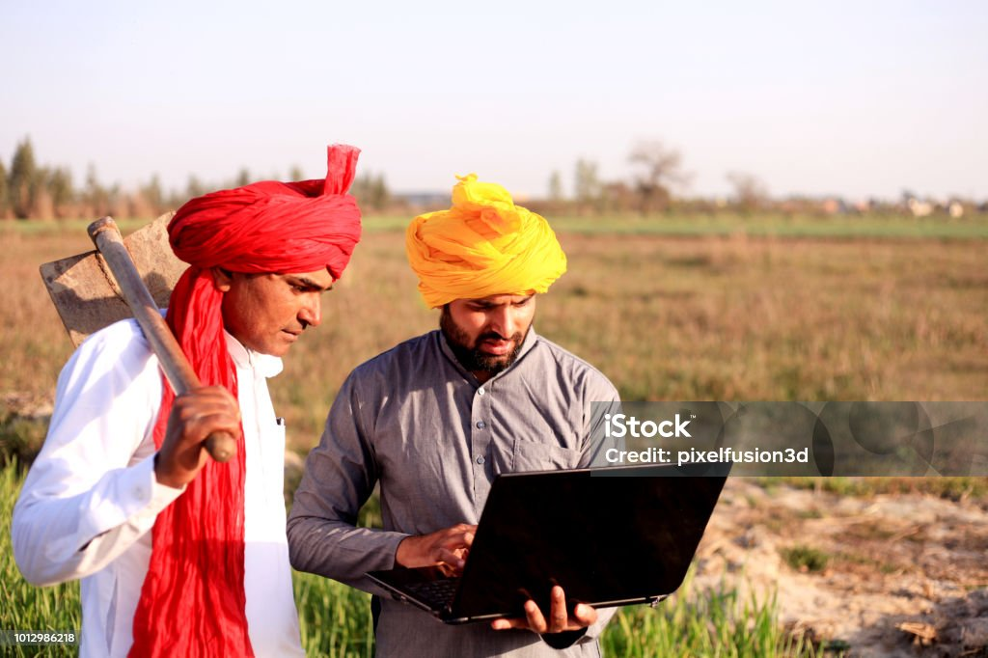
IMPACT AND BENEFITS
Innovatex
Potential Impact on the Target Audience:
Farmers:
Income Stability: Secure contracts ensure stable and predictable income.
Market Access: Easier access to a wider market.
Empowerment: Improved bargaining power through transparent tools.
Buyers:
Reliable Supply: Guaranteed supply from trusted farmers.
Quality Assurance: Verified, quality-controlled produce.
Agricultural Sector:
Market Efficiency: Better alignment of supply and demand.
Innovation Adoption: Drives modernization with digital tools.
Benefits:
Social: Empowers communities with fair trade and digital tool training. Economic: Boosts farmer income through better market access and reduces costs with automation. Environmental: Promotes sustainable practices and optimizes resource use. Additional: Enhances trust with transparent contracts and offers valuable market insights.

Slide 6



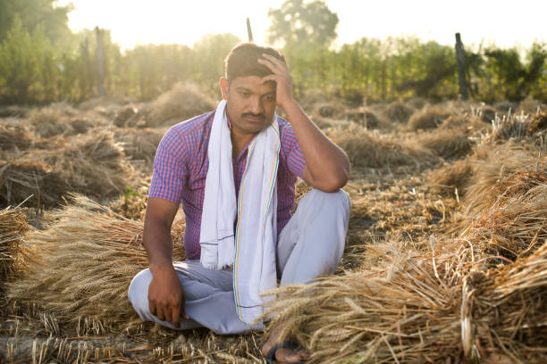

RESEARCH AND REFERENCES
Innovatex
1.Farmer Suicides in India:
Statistics: The National Crime Records Bureau (NCRB) reported that over 10,000 farmers and agricultural laborers died by suicide in 2019 due to financial stress and unstable income.
Source: https://ncrb.gov.in/
2. Importance of Market Access:
Study: Research shows that limited market access contributes significantly to financial instability among farmers, often leading to distress and debt.
Source: https://www.fao.org/
3. Digital Tools in Agriculture:
Insight: Digital tools in agriculture can boost farmer income by 20-30% by enhancing market access and reducing transaction costs.
Source: https://www.mckinsey.com/
How Our Project Can Help:
Impact: By providing a platform for assured contract farming, our project can directly address the financial instability that drives many farmers to despair. It offers reliable market access, secure contracts, and timely payments, which can significantly reduce financial stress, helping prevent the tragic loss of lives due to economic hardship.

